Slide 1
Operating System
Lect 10

Slide 2
Multilevel QUEUE Scheduling
A class of scheduling algorithm has been created for situation in which processes ar easily classified into different groups.
System Processes
(Interupt)
Forground Processes
(Interactive)
They have:
Different response time requirements
Different Scheduling needs
Background Processes
(Batch)
Forground Processes may have priority (externally defined) over Background Processes
This algorithm have several seperate ready queues
The processes are permanently assigned to one queue, generally based on some property of the process, such as same memotu size, process priority, or process type.
Each queue has its own scheduling algorithm

Slide 3
Example
seperate que might be use for Forground Processes& Background Processes
Forground queue might be scheduled by RR algo, while Background queue might be scheduled by FCFS algo and so on.
System Process
RR
Higher Priority
Interactive Process
SJF
CPU
Medium Priority
Batch Process
FCFS
Lower Priority

Slide 4
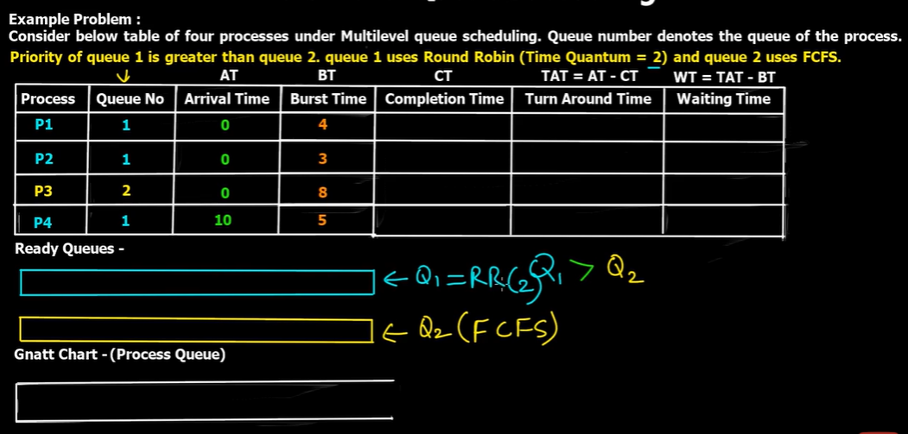

Slide 5
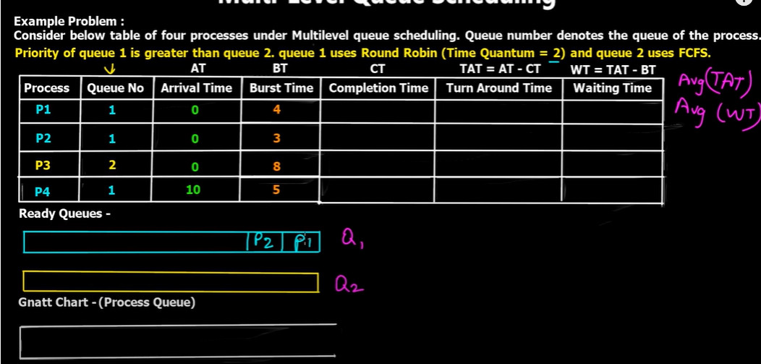

Slide 6
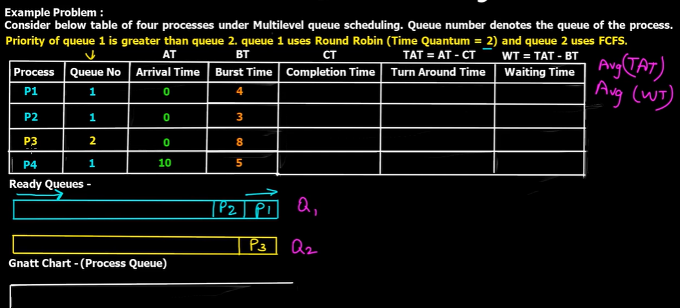

Slide 7
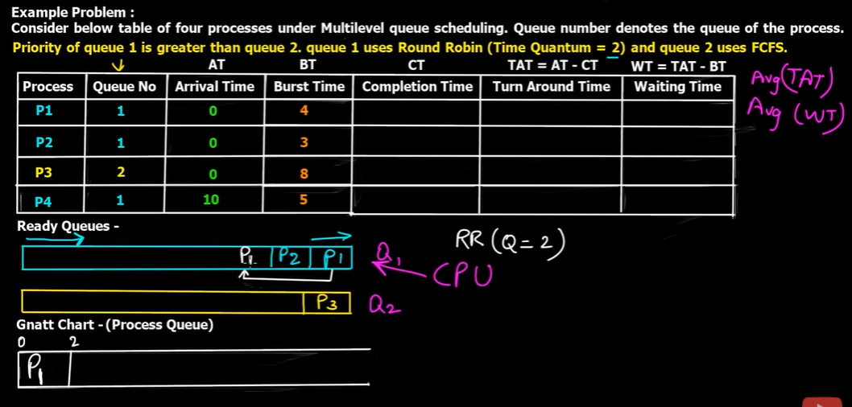

Slide 8
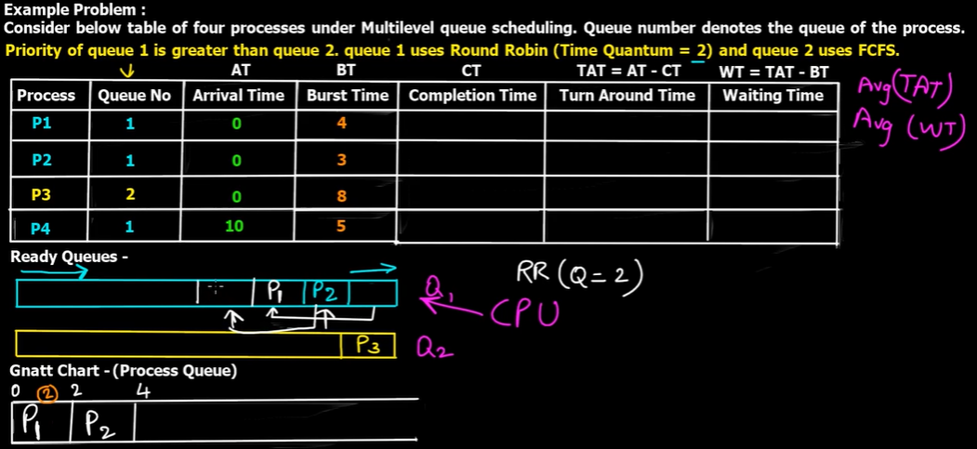

Slide 9
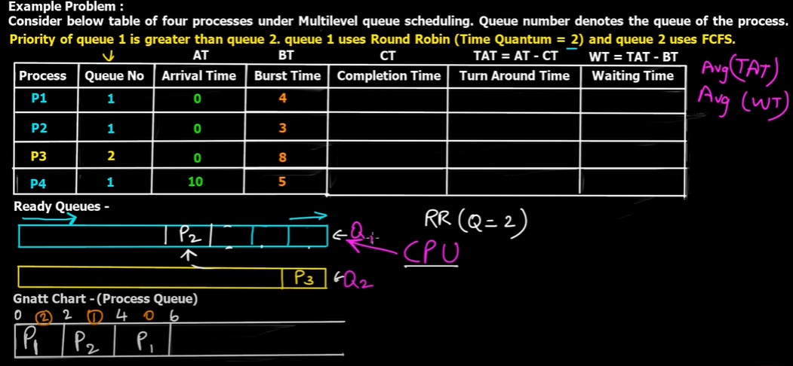

Slide 10
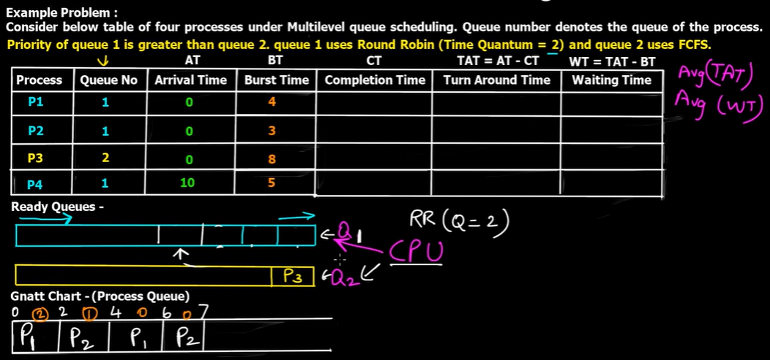

Slide 11
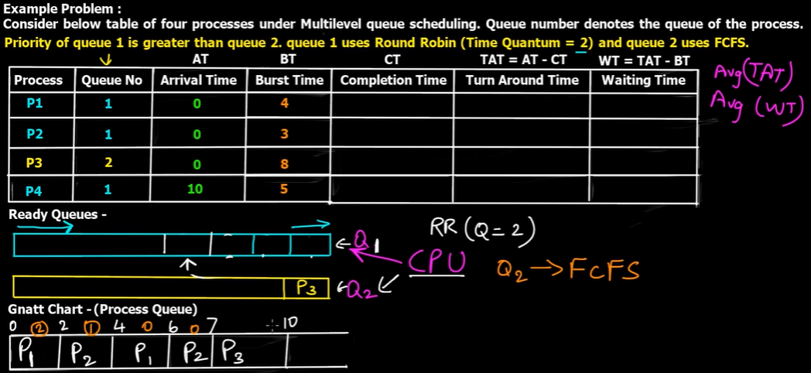

Slide 12


Slide 13
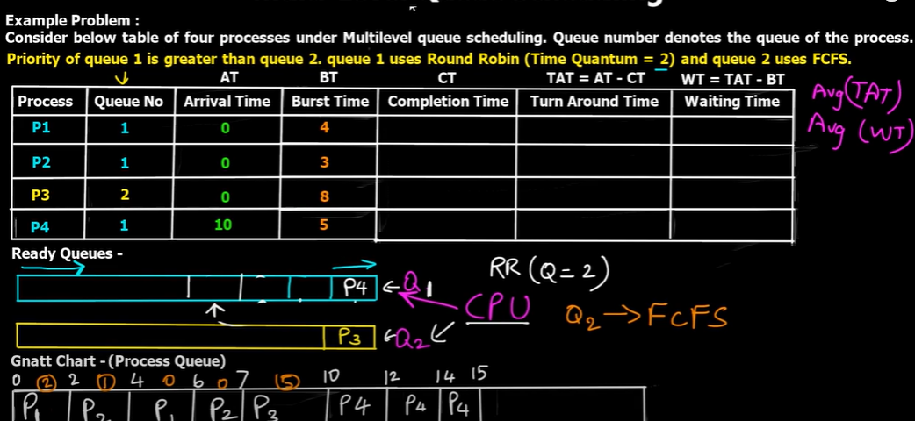

Slide 14
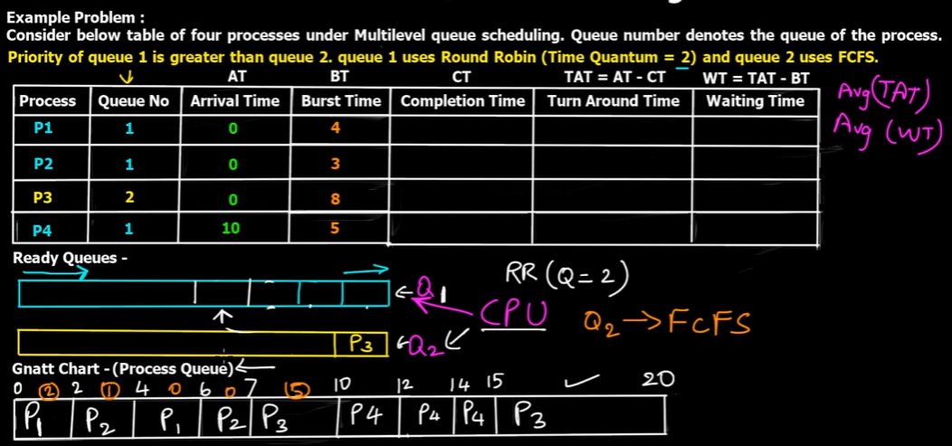

Slide 15
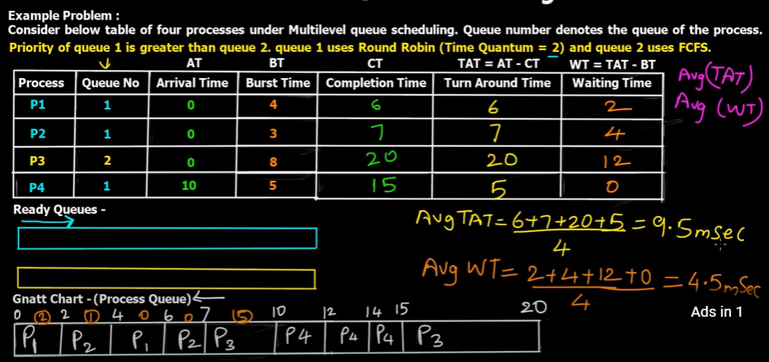

Slide 16
Advantage & Problem
Advantage
We are catergorized the proccess according their different different real time scnario
Problem
if system processes come consequetively so there is no turn for interactive and batch processes. interactive and batch processes run on CPU lately. This situation called starvation.

Slide 17
Starvation problem can be resolve by Multilevel Feedback queue scheduling Algorithm

Slide 18
Multilevel Feedback queue scheduling Algorithm

Slide 19
Multilevel Feedback queue scheduling Algorithm
Multilevel Feedback queue scheduling Algorithm allows a process to move between queues
The idea is to seperate processes according to the characeristics of their CPU brusts.
If a process uses too much CPU time, it will be move to a lower-priority queue.
This scheme leaves I/O-bound and interactive processes in the higher-priority queue.
A process that waits too long in a lower-priority queue may be moved to a higher-priority queue.
This form of aging prevents startvation

Slide 20
Example
Lower Priority
RQ1 TQ=2
If complete the out
RQ2 TQ=4
If complete the out
RQ3 TQ=8
If complete the out
If complete the out
RQ4 FCFS
Higher Priority

Slide 21
Example
Lower Priority
RQ1 TQ=2
If complete the out
P1
If P1(lower priority) has excution time =19
19-2= 17 run in lower priority.
RQ2 TQ=4
If complete the out
RQ3 TQ=8
If complete the out
RQ4 FCFS
If complete the out
Higher Priority

Slide 22
Example
Lower Priority
RQ1 TQ=2
If complete the out
If P1(lower priority) has excution time =19
19-2= 17 run in lower priority.
After 2 quantum, P1 move toward on next queue where it can run up to 4 quantum time
so 17-4=13
RQ2 TQ=4
If complete the out
P1
RQ3 TQ=8
If complete the out
If complete the out
RQ4 FCFS
Higher Priority

Slide 23
Example
Lower Priority
RQ1 TQ=2
If complete the out
If P1(lower priority) has excution time =19
19-2= 17 run in lower priority.
After 2 quantum, P1 move toward on next queue where it can run up to 4 quantum time
so 17-4=13
After 4 quantum, P1 move toward on next queue where it can run up to 8 quantum time
so 13-8=5
RQ2 TQ=4
If complete the out
RQ3 TQ=8
If complete the out
P1
If complete the out
RQ4 FCFS
Higher Priority

Slide 24
Example
Lower Priority
RQ1 TQ=2
If complete the out
If P1(lower priority) has excution time =19
19-2= 17 run in lower priority.
After 2 quantum, P1 move toward on next queue where it can run up to 4 quantum time
so 17-4=13
After 4 quantum, P1 move toward on next queue where it can run up to 8 quantum time
so 13-8=5
After 8 quantum, P1 move toward on next queue where it can run on FCFS which its nonpreemptive algorithm where process completely run.
RQ2 TQ=4
If complete the out
RQ3 TQ=8
If complete the out
If complete the out
RQ4 FCFS
P1
P1
Higher Priority

Slide 25
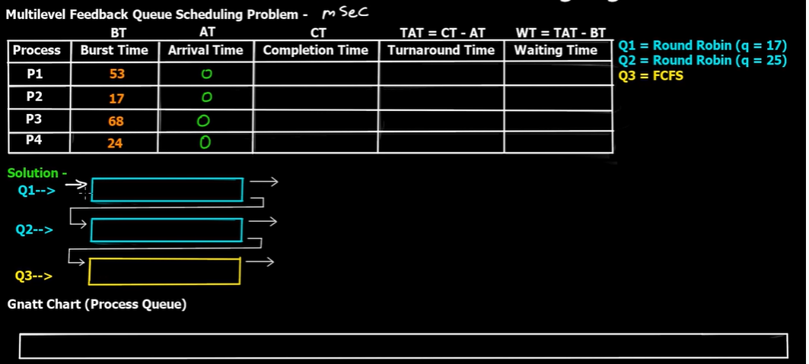

Slide 26
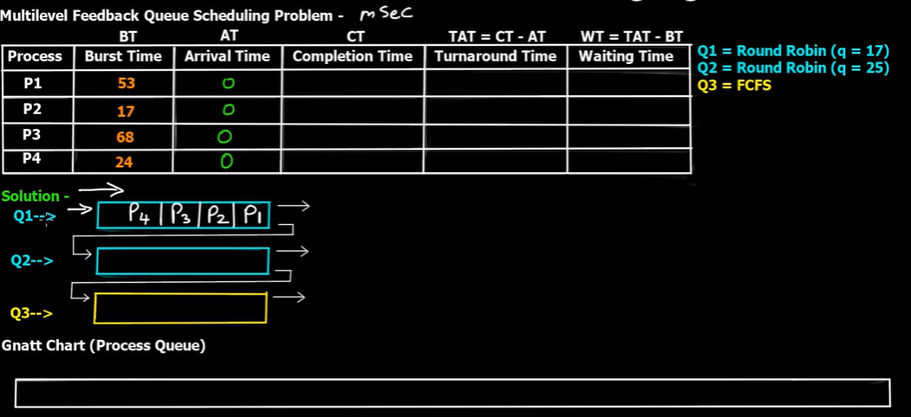

Slide 27
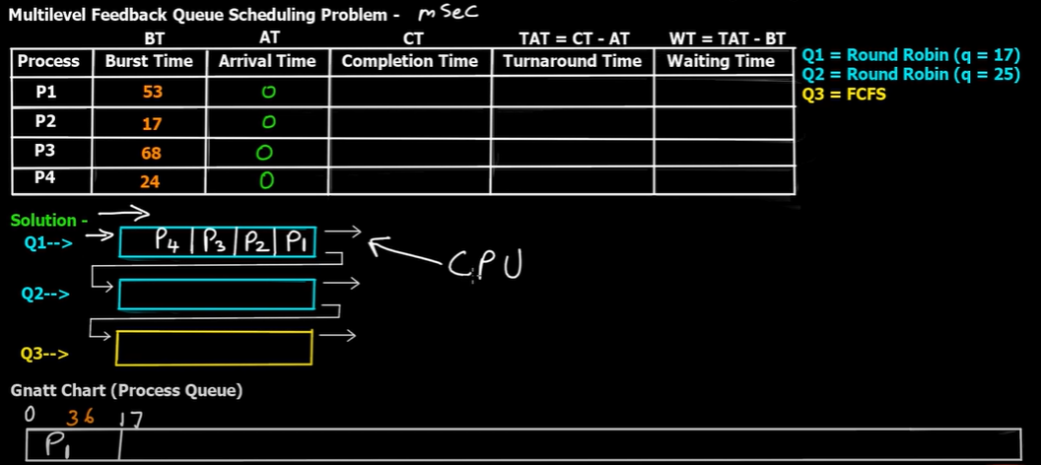

Slide 28
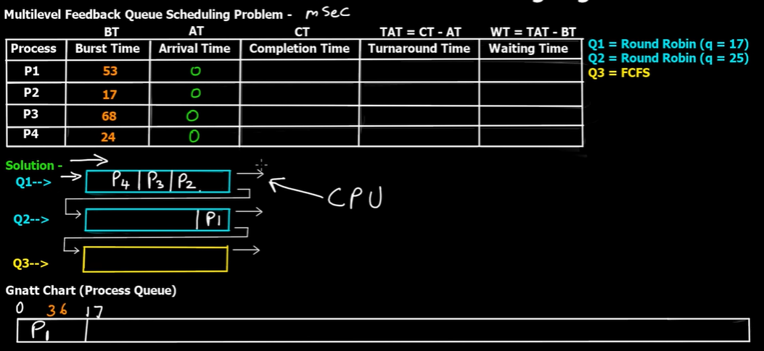

Slide 29
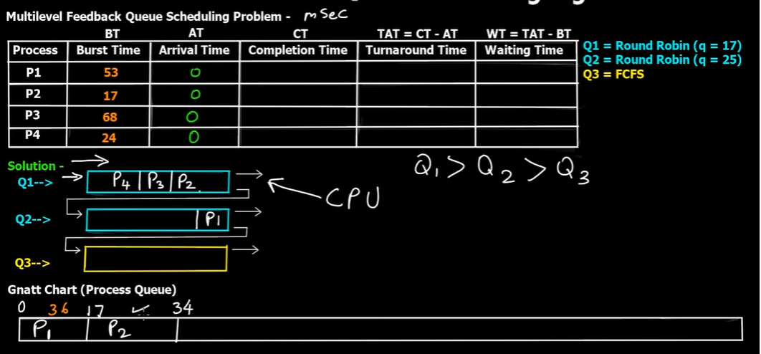

Slide 30
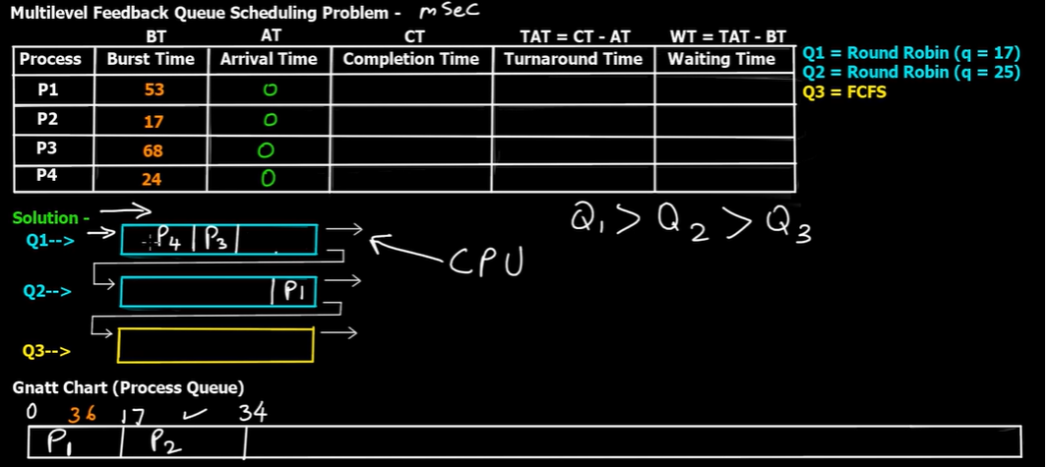

Slide 31
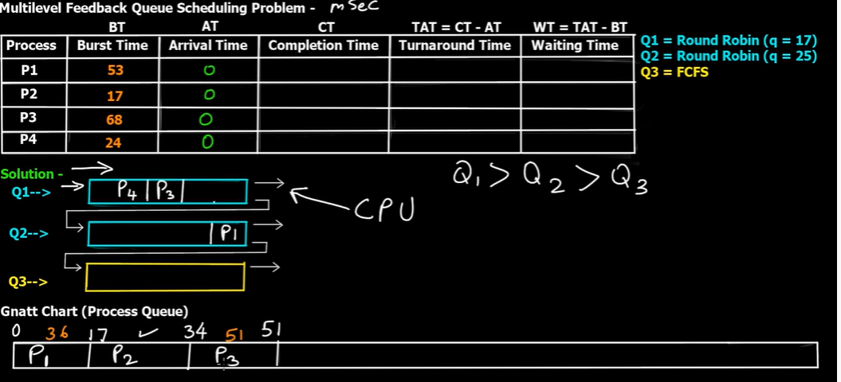

Slide 32
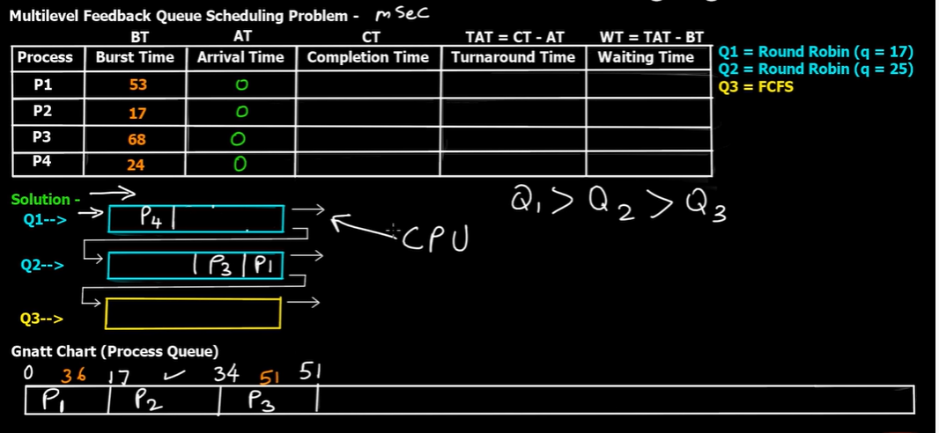

Slide 33
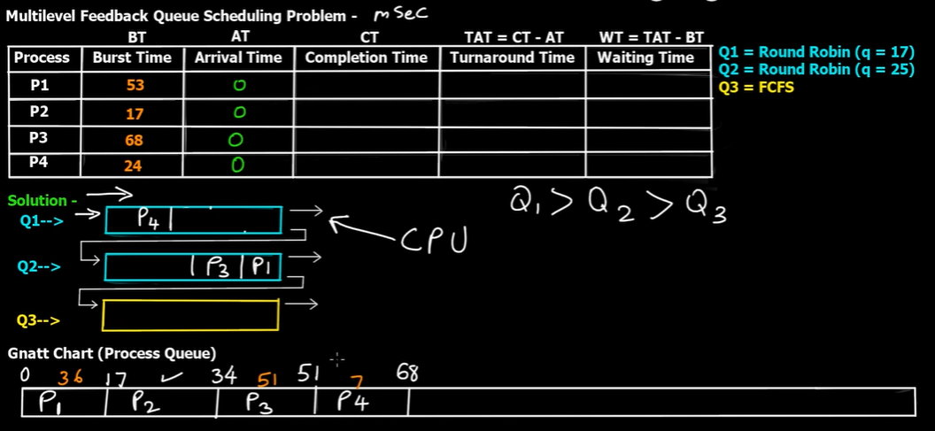

Slide 34
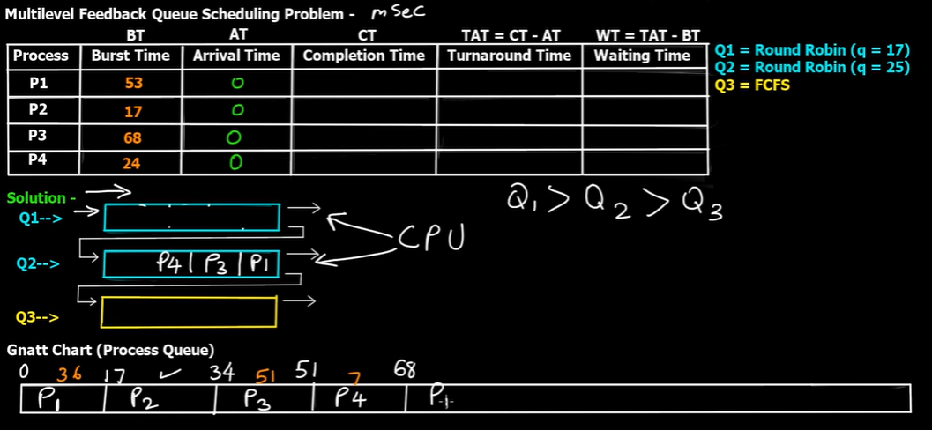

Slide 35
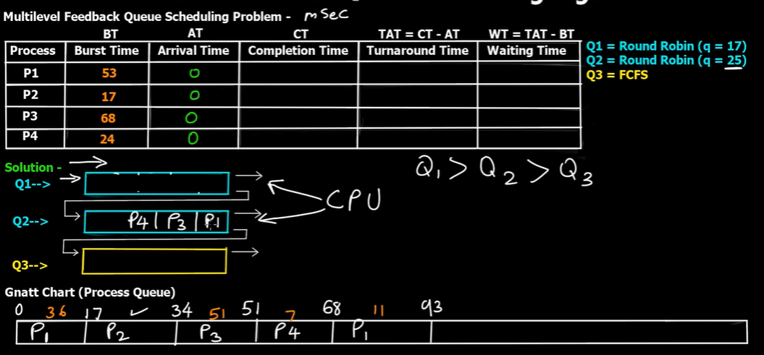

Slide 36
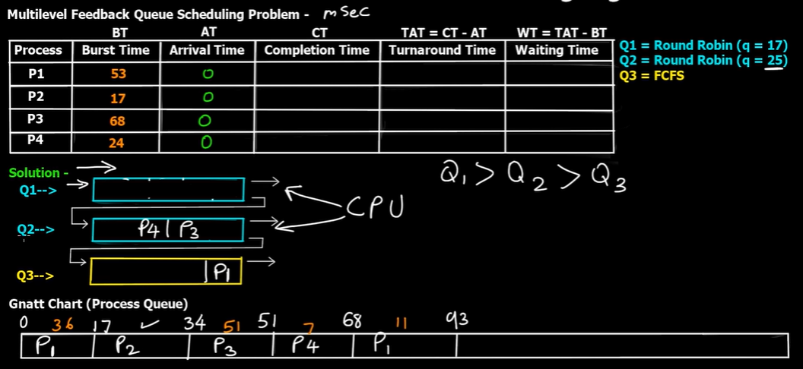

Slide 37
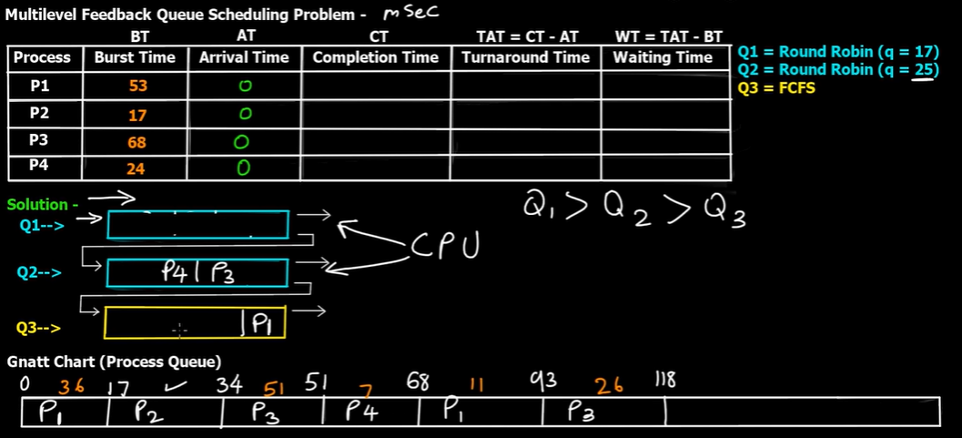

Slide 38
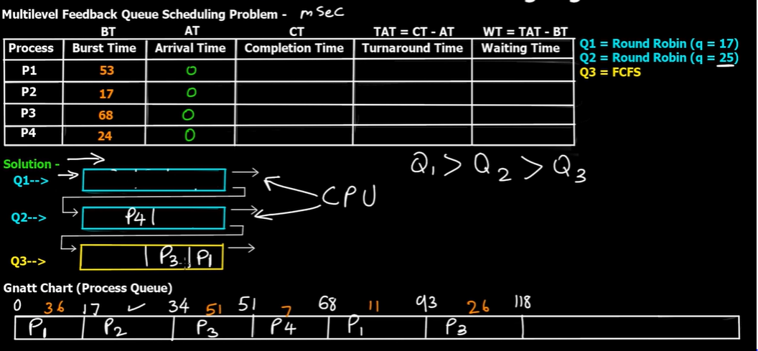

Slide 39
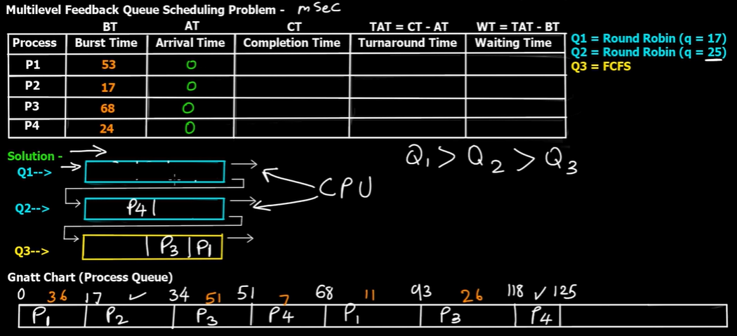

Slide 40
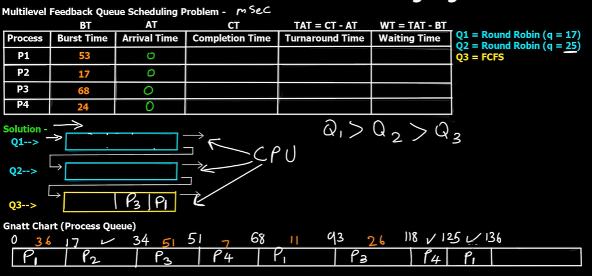

Slide 41
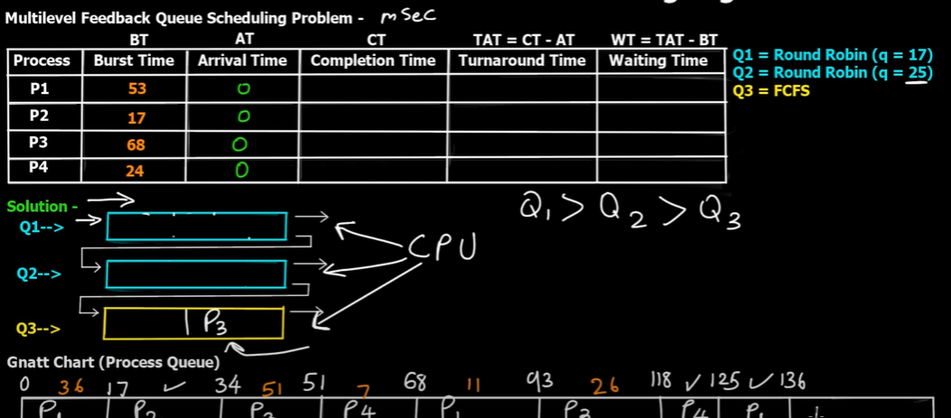

Slide 42
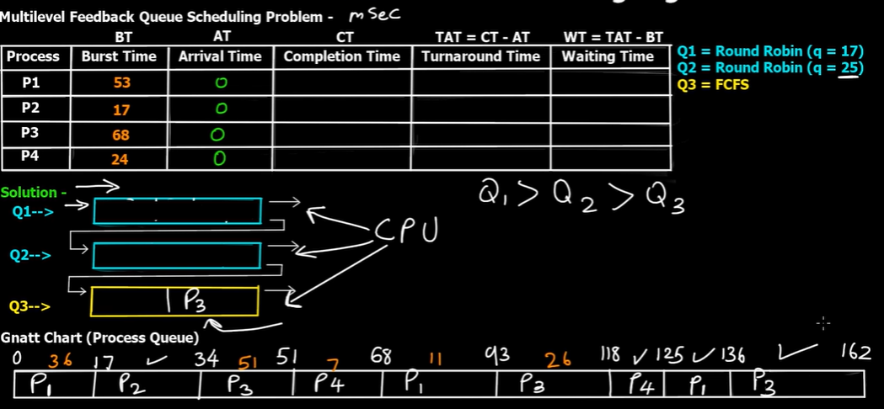

Slide 43
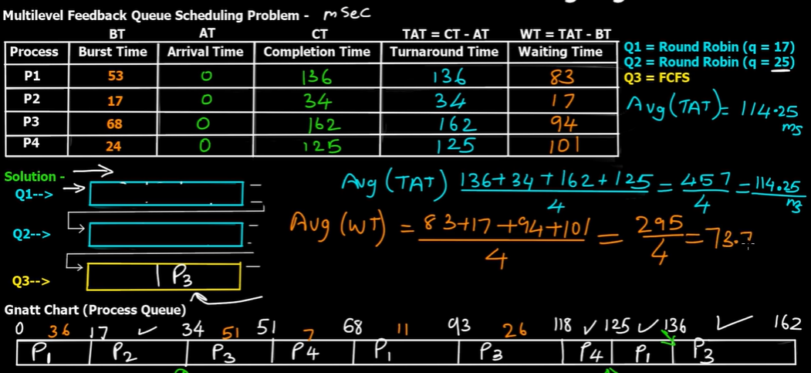

Slide 44
Process Syncronization

Slide 45
Process Syncronization
if system process multiple process so it can have two mode parallel or serial
In serial mode one process run at a time like user of ATM machine.
In parallel mode, several process run a single time due to multiple precessor. Here, we have two types process
Process Syncronization in Parallel mode
Cooperative Process
Independent Process
Execution of one process efects the execution of other
Execution of one process doesnot efect the execution of other

Slide 46
Critical section
Critical section is apart of the program where shared resources are access by various processes (cooperative processes).
Process Syncronization in Parallel mode
Cooperative Process
Independent Process
They can shared variable, memomory, code or resources(printer, scanner, cpu).
It face crucial point, if they shared something common,Execution of one process efects the execution of other

Slide 47
Example
int shared=5
constrain= 1 CPU (Uni processor system)
P1
int X=Shared ;
X++;
sleep(1);
shared=x;
P2
int Y=Shared ;
Y--;
sleep(1);
shared=Y;

Slide 48
Example
int shared=5
constrain= 1 CPU (Uni processor system)
P1
int X=Shared ;
X++;
sleep(1);
shared=x;
P2
int Y=Shared ;
Y--;
sleep(1);
shared=Y;
critical section
6

Slide 49
Example
int shared=5
constrain= 1 CPU (Uni processor system)
P1
int X=Shared ;
X++;
sleep(1);
shared=x;
P2
int Y=Shared ;
Y--;
sleep(1);
shared=Y;
critical section
4

Slide 50
Example
int shared=5
constrain= 1 CPU (Uni processor system)
P1
int X=Shared ;
X++;
sleep(1);
shared=x;
P2
int Y=Shared ;
Y--;
sleep(1);
shared=Y;
shared=6
terminte

Slide 51
Example
int shared=5
constrain= 1 CPU (Uni processor system)
P1
int X=Shared ;
X++;
sleep(1);
shared=x;
P2
int Y=Shared ;
Y--;
sleep(1);
shared=Y;
shared=4
terminate

Slide 52
Example
int shared=5
6 4
constrain= 1 CPU (Uni processor system)
P1
int X=Shared ;
X++;
sleep(1);
shared=x;
P2
int Y=Shared ;
Y--;
sleep(1);
shared=Y;
if we add or sub from some value it return back to its origin. but here come wrong because both process are not syncronized. This problem called Race condition.
This roblem solved by various syncronization mechanism

Slide 53
what are conditions/ objective required for the perfect syncronization
Every syncronization mechanism to acheive perfect process syncronization it should be fully satisfy following conditions.
Mutual Exclusion
At a time one process exist /access in critical section, other process have to wait outside the critical section/ cannot allow the entery.
Progress
if P1 not intrested to access critical section. At the same time other process intrested to access critical section but P1 stopping P2 to get access the critical section). This condition should be satisfy. it should never stop other procces to get access of critical section
Bounded waiting
When P1 get access critical section. it should be inform other processes about their brust time before getting access.if brust time is infinite so it is the voilation of bounded waiting.
No assumption related to H/W and speed
Every syncronization mechanism should compatible with each and every H/W and their speed. Every syncronization mechanism should be portable (mean work on every OS).
Critical Section(CS)
P1
P2

Slide 54
Synronization Mechanism
Syncronization Mechanism
Busy Waiting
without Busy waiting
P2
Critical Section(CS)
Critical Section(CS)
P1
P1
When P1 access CS and P2 waiting for it. if P2 waiting for Critical section in CPU it wasting CPU Time
When P1 access CS and P2 waiting for it but P2 not wait in CPU so it not wasting CPU Time

Slide 55
Process Syncronization
Synronization Mechanism
Lock variable(1st Solution)
Solution of Critical solution(Busy waiting)

Slide 56
Lock Variable(Solution of Busy waiting ) oldest methodology
It is a software mechanism(user mode)
More than 2 process
initial Lock=0
Critical Section(CS)
While(lock!=0)
Lock =1
Entry section
P1
P2
CS
Lock =0
Exit section

Slide 57
Lock Variable(Solution of Busy waiting ) oldest methodology
It is a software mechanism(user mode)
More than 2 process
initial Lock=0
Critical Section(CS)
While(lock!=0)
Lock =1
Entry section
P1
P2
CS
Lock =0
Exit section
case 1
P1 P2
Line 12 3 execute & lock become 1
At a same time If P2 want to get access but it cannot access because Lock=1

Slide 58
Lock Variable(Solution of Busy waiting ) oldest methodology
It is a software mechanism(user mode)
More than 2 process
initial Lock=0
Critical Section(CS)
While(lock!=0)
Lock =1
Entry section
when P1released critical section after its execution, lock become 0 again.This time P2 can aceess critical section
P1
P2
CS
Lock =0
Exit section
case 1
P1 P2
Line 12 3 execute & lock become 1
At a same time If P2 want to get access but it cannot access because Lock=1

Slide 59
Lock Variable(Solution of Busy waiting ) oldest methodology
It is a software mechanism(user mode)
More than 2 process
Critical Section(CS)
initial Lock=0
P1
P2
While(lock!=0)
Lock =1
Entry section
CS
case 2
P1 P2
Line 1 execute & lock become 1. but unfortunately P1 preempt by algorithm
At a same time If P2 want to get access Here, Line 12 3 execute & lock become 1. P2 entry in CS and start their execution.
Lock =0
Exit section
Now P1 come back to get access of CS. It cannot access it never run line one once again at second time because it remember lock is 1.

Slide 60
Lock Variable(Solution of Busy waiting ) oldest methodology
It is a software mechanism(user mode)
More than 2 process
Critical Section(CS)
initial Lock=0
While(lock!=0)
Lock =1
P1
P2
Entry section
CS
case 2
P1 P2
Line 1 execute & lock become 1. but unfortunately P1 preempt by algorithm
At a same time If P2 want to get access Here, Line 12 3 execute & lock become 1. P2 entry in CS and start their execution.
Lock =0
Exit section
Now P1 come back to get access of CS. It cannot access it never run line one once again at second time because it remember lock is 1 and start execution

Slide 61
Lock Variable(Solution of Busy waiting ) oldest methodology
It is a software mechanism(user mode)
More than 2 process
Critical Section(CS)
initial Lock=0
While(lock!=0)
Lock =1
P1
P2
Entry section
CS
This time P1 and P2 both are in critical section that breaks Mutual exclusion rule.Lock variable solution fails here.
Lock =0
Exit section
Rule of Mutual Exclusion
At a time one process exist /access in critical section, other process have to wait outside the critical section/ cannot allow the entery.

Slide 62
Process Syncronization
Synronization Mechanism
Test and Set Lock (TSL)(2nd Solution)
Solution of Critical solution(Busy waiting)

Slide 63
Test and Set Lock (TSL)
It is a software mechanism(user mode)
More than 2 process
initial Lock=0
Problem
Preemption
Critical Section(CS)
While(lock!=0)
Lock =1
Entry section
P1
P2
CS
Lock =0
Exit section

Slide 64
Test and Set Lock (TSL)
It is a software mechanism(user mode)
More than 2 process
it combine these two lines
initial Lock=0
While(lock!=0)
Lock =1
While Test-and-Set (&lock)
Entry section
Entry section
CS
CS
Lock =0
Lock = 0
Exit section
Exit section

Slide 65
Test and Set Lock (TSL)
It is a software mechanism(user mode)
More than 2 process
While Test-and-Set (&lock)
it conbine these two lines
Boolean Test-and-Set (boolean *target);
{
boolean r =*target;
*target= True;
return r;
}
While Test-and-Set (&lock)
Entry section
CS
Lock = 0
Exit section
Lock
Target
r
False
1000
False

Slide 66
Test and Set Lock (TSL)
While Test-and-Set (&lock)
It is a software mechanism(user mode)
More than 2 process
Boolean Test-and-Set (boolean *target);
{
boolean r =*target;
*target= True;
return r;
}
P1
it conbine these two lines
While Test-and-Set (&lock)
Entry section
Target is memory address.It points the lock
Lock is false initially. r become false here due to line 2 execution.
CS
Lock
Target
r
Lock = 0
False
1000
False
Exit section
1000

Slide 67
Test and Set Lock (TSL)
While Test-and-Set (&lock)
It is a software mechanism(user mode)
More than 2 process
Boolean Test-and-Set (boolean *target);
{
boolean r =*target;
*target= True;
return r;
}
P1
it conbine these two lines
While Test-and-Set (&lock)
Entry section
Target is memory address.It points the lock
Lock is false initially. r become false here due to line 2 execution.
lock become True due to line 3 execution.
Return r which is false
CS
Lock
Target
r
Lock = 0
True
False
1000
False
Exit section
1000

Slide 68
Test and Set Lock (TSL)
While Test-and-Set (&lock)
P1
It is a software mechanism(user mode)
More than 2 process
Boolean Test-and-Set (boolean *target);
{
boolean r =*target;
*target= True;
return r;
}
P2
it conbine these two lines
Entry section
While Test-and-Set (&lock)
Target is memory address.It points the lock
Lock is True. r become True here due to line 2 execution.
lock become True due to line 3 execution.
Return r which is false
Due to this it stuck here
CS
P2 cann t get access of CS
so mutual exclusion acheived
it achevied progress also because if CS is blank any process can get access of CS
Lock
Target
r
Lock = 0
True
1000
True
Exit section
1000

Slide 69
Process Syncronization
Synronization Mechanism
Turn Variable(3rd Solution)
Solution of Critical solution(Busy waiting)

Slide 70
Turn Variable (Strict Alteration)
It is a software mechanism(user mode)
Only for 2 process
initial Turn=0
P0 | P1
While(lock!=0); CS Lock =1 | While(lock!=1); CS Lock =0
Entry section
Exit section

Slide 71
Turn Variable (Strict Alteration)
It is a software mechanism(user mode)
Only for 2 process
initial Turn=0
P0 | P1
While(lock!=0); CS Lock =1 | While(lock!=1); CS Lock =0
Entry section
Exit section
Critical Section(CS)
P1
P2

Slide 72
Turn Variable (Strict Alteration)
It is a software mechanism(user mode)
Only for 2 process
initial Turn=1
P0 | P1
While(lock!=0); CS Lock =1 | While(lock!=1); CS Lock =0
Entry section
So Mutual Exclusive condition is satisfied here.
and it also achevied Bounded waiting and No assumption related to H/W and speed too. it also satisfy but it cant achevied progress
Exit section
Critical Section(CS)
P2
P1

